Slide 1
CRYPTOSYSTEM
Rivest–Shamir–AdlEman

Slide 2
BACKGROUND AND IMPORTANCE
Cryptosystem

Slide 3
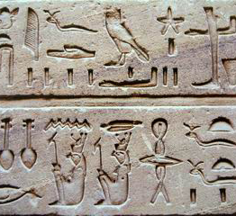
tomb of the nobleman Khnumhotep II
Inscription carved around 1900 BC
Use of unusual hieroglyphic symbols

Slide 4
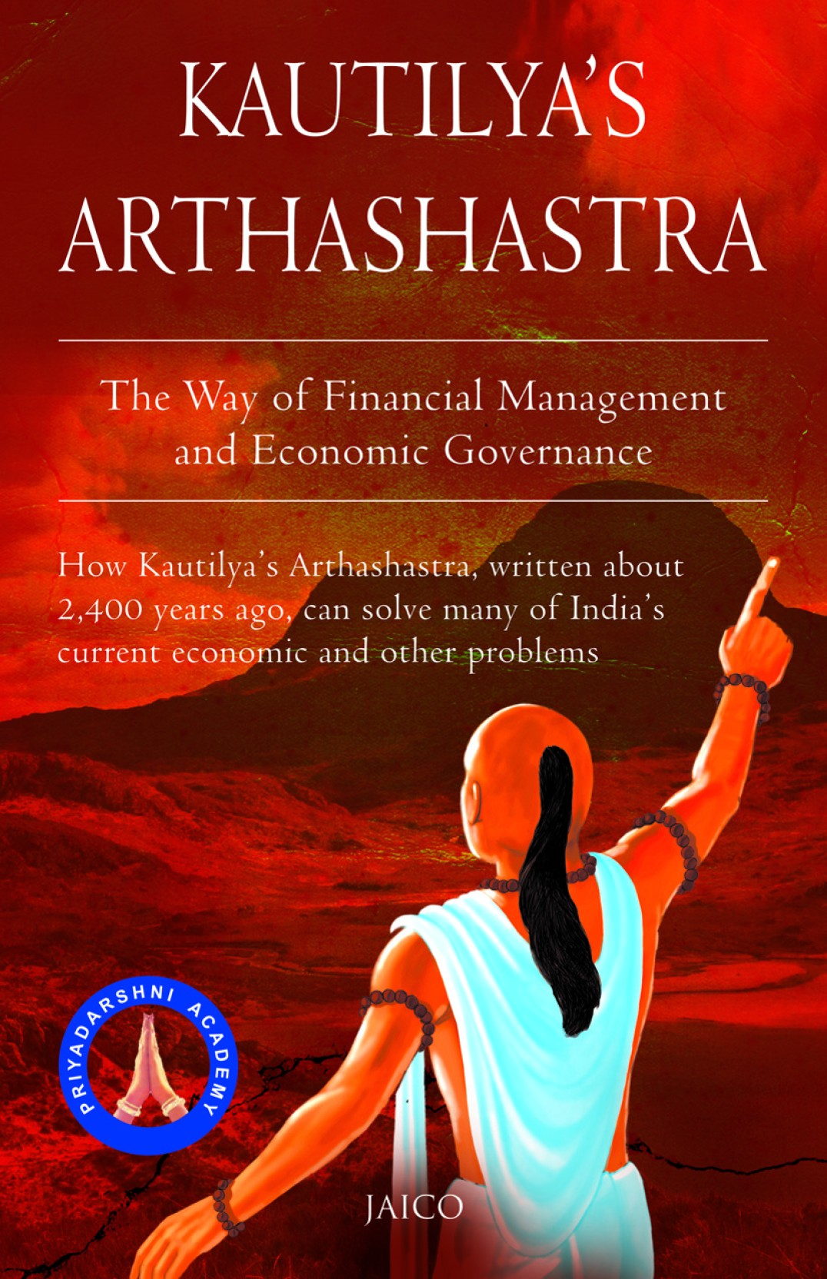
"Arthshashtra", a classic work on statecraft written by KautIlya,
Describes the espionage service in India
Mentions giving assignments to spies in "secret writing“
Sounds like an ancient version of James Bond?

Slide 5
Now Come:
Our Heroes
Julius Caesar
Rivest–Shamir–AdlEman

Slide 6
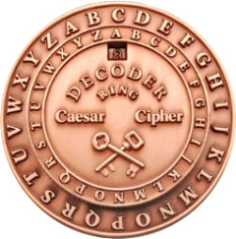
Caesar’s Cipher
To convey secret messages to his army generals
The variant used by Caesar was a shift by 3 cipher

Slide 7

Ron Rivest Adi Shamir Leonard Adelman - THE R.S.A
First Practical Public Key Cryptosystem
Two Different Keys
Private (Decryption)
Public (Encryption)
Based on Large Prime Numbers

Slide 8
COMING TOWARDS THE IMPORTANCE
CRYPTOSYSTEM

Slide 9

Simple Answer
Do you want anyone to be able to read your emails?
How about access your bank account when they need a little extra cash?
Maybe even gallivant around pretending to be you on the Internet?
Doesn't sound too good? Well this is where cryptography comes in.

Slide 10





The Picture Says it all
Data on the Cloud
Drive
Google Photos
Online Banking
Emails
Personal Data on PC
Home Networks
Our Data is Waiting to Be Encrypted

Slide 11
COMING TO OUR ENCRYPTION TECHNIQUE
THE RSA

Slide 12
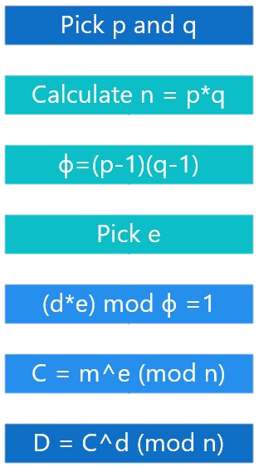
Algorithm
Election of Prime Numbers
Calculating the Modulus
Calculation of Ф(n)
Finding the Encryption Key
Finding the Decryption Key
Encryption Function
Decryption Function

Slide 13
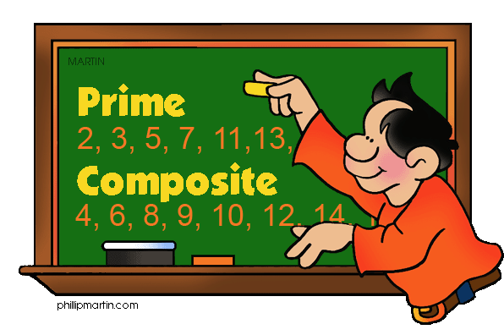
Choose two Prime Number
Construct their Product that is
N = P*Q
Finding Ф(n)
Ф(n) = (P-1)*(Q-1)

Slide 14
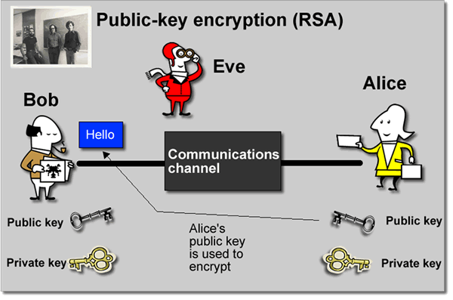

Generation of an Encryption Key
1 < e < Ф(n)
*e should be co prime of Ф(n)
Generation of Decryption Key
d*e mod n = 1
Encryption Function
C $=M^{e} mod n$
Decryption Function
P $=C^{d} mod n$

Slide 15
Let’s See The Flowchart
The Rsa

Slide 16
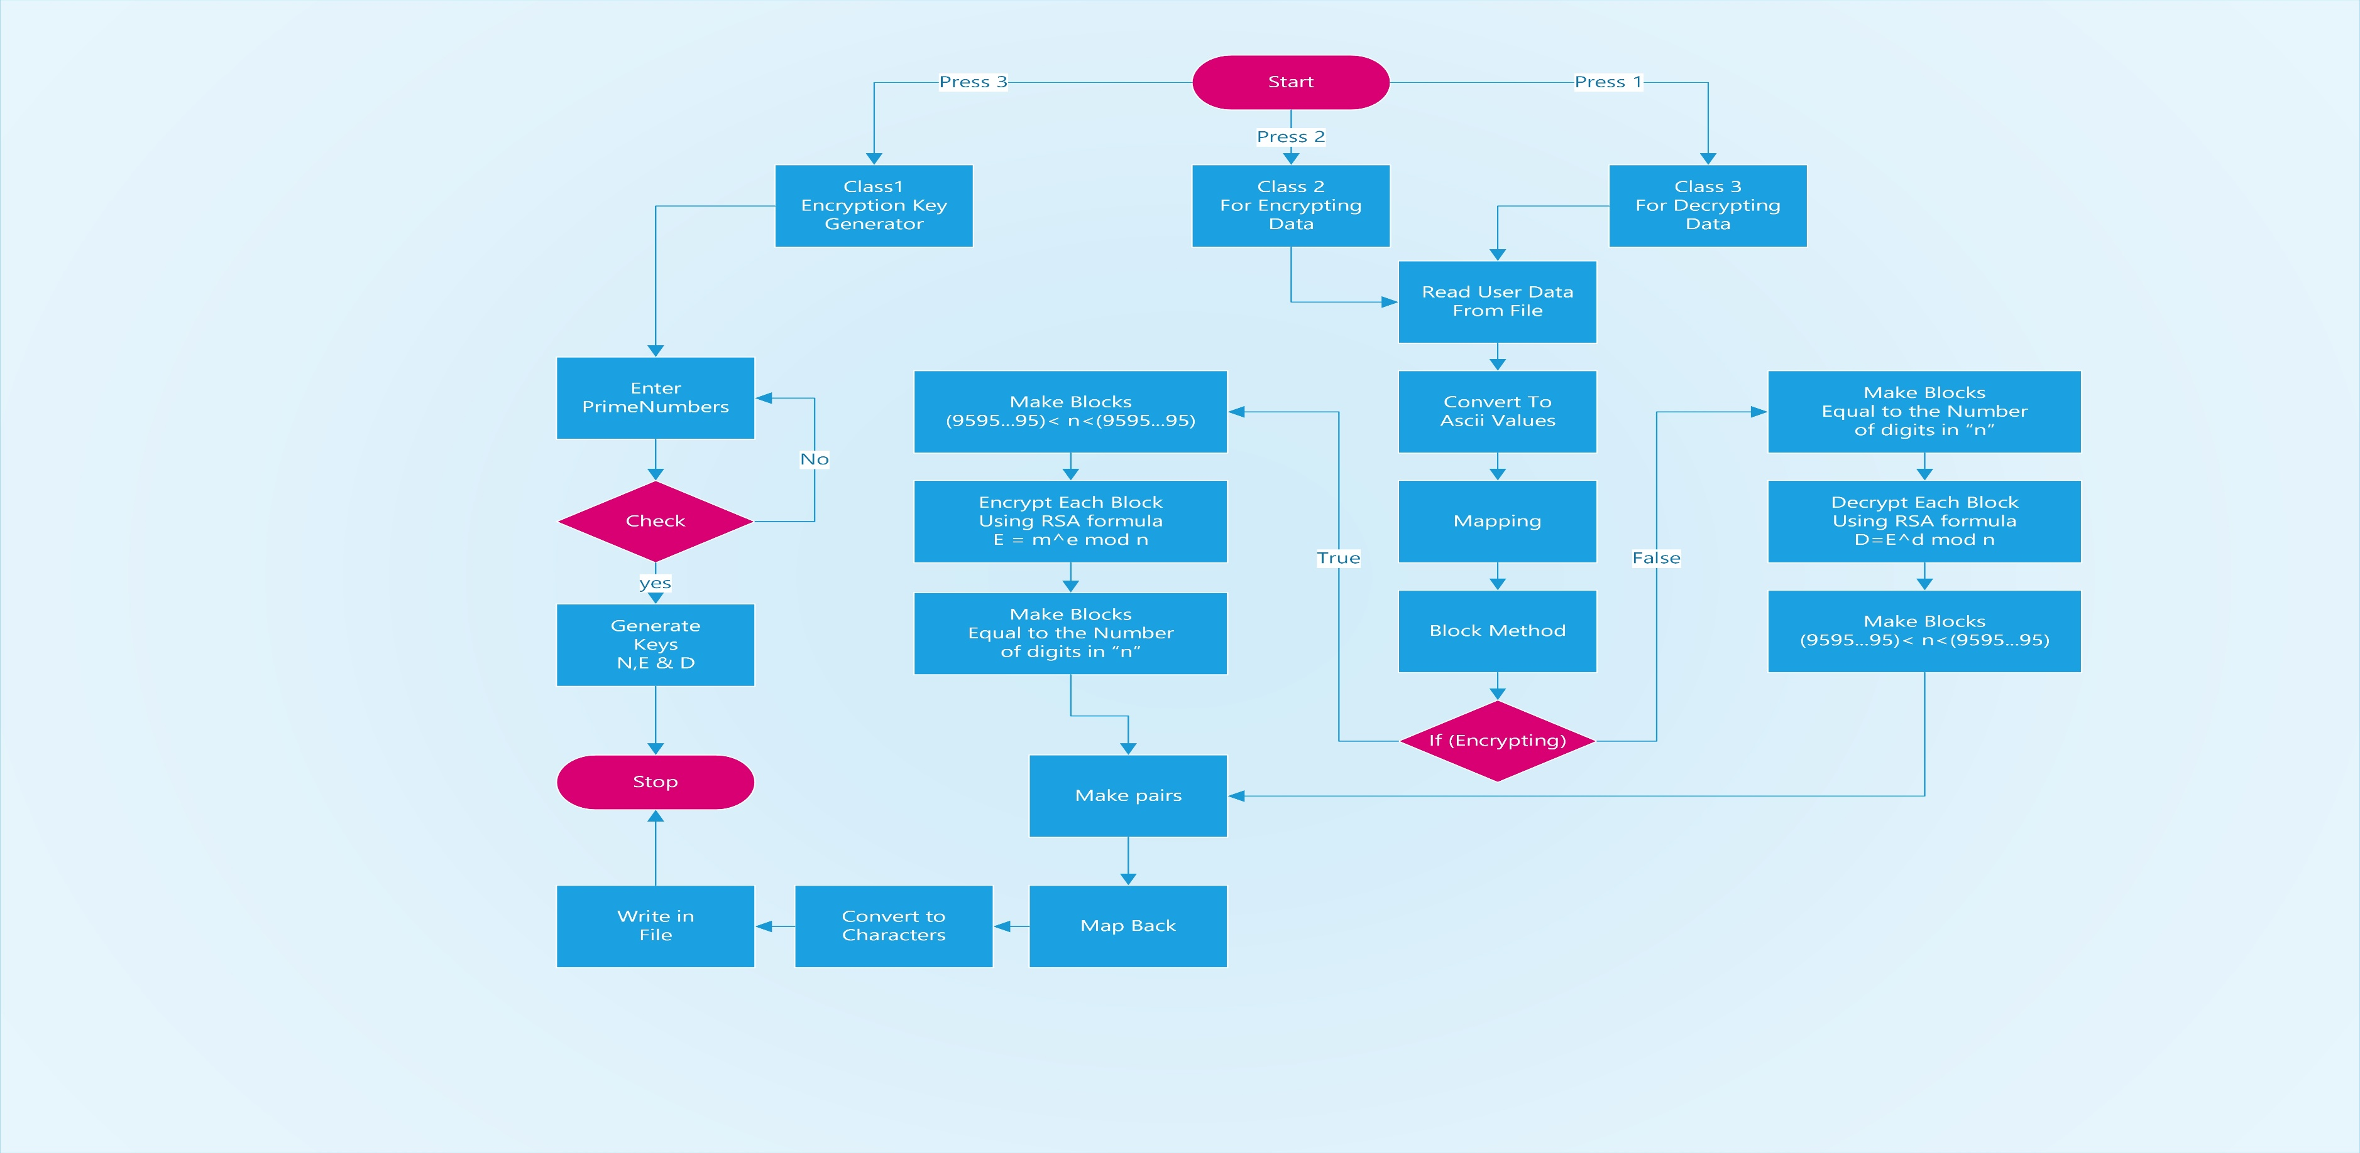
Flow Chart

Slide 17
Coming To The Example Of RSA
Cryptosystem

Slide 18
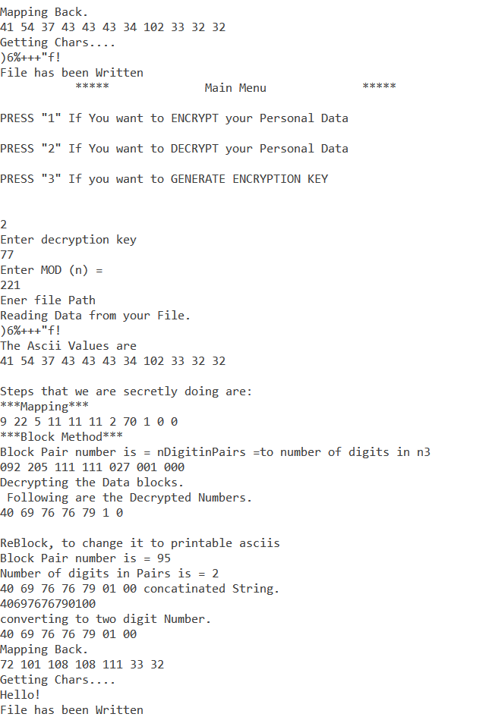
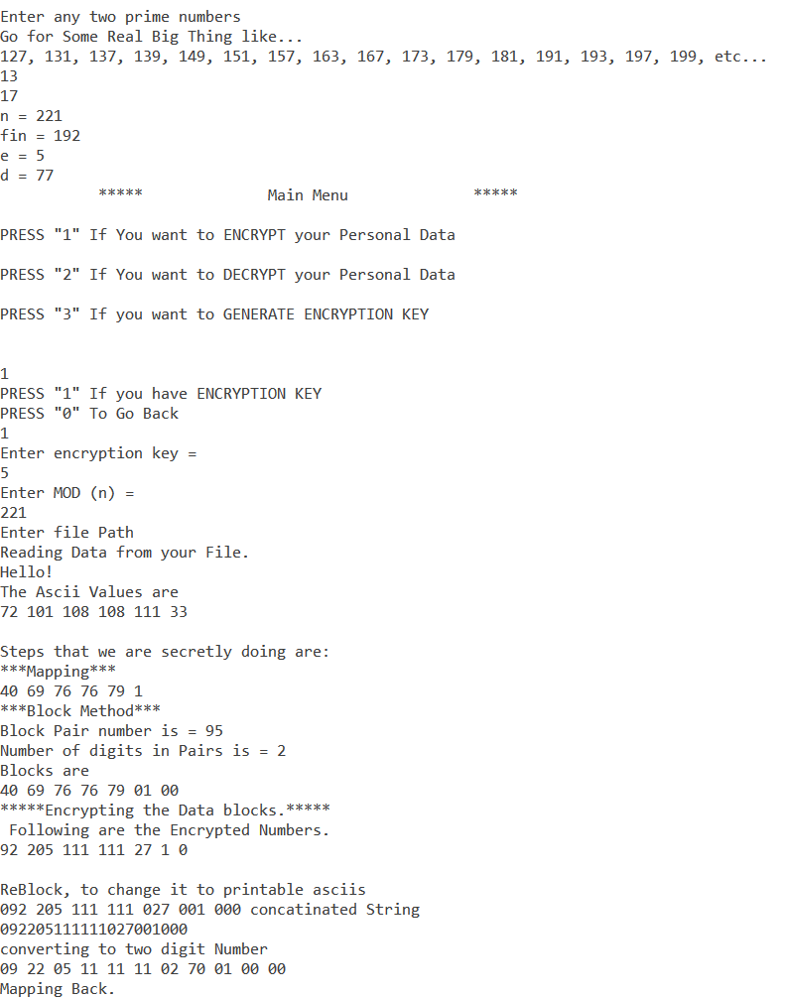
Example
Choose two Different prime Numbers, Enter the Text you want to Encrypt
Now
Let the Program Handle it
→ Picture
Public Key ✓
Modulus ✓
Private Key ✓
Encryption ✓
Decryption ✓

Slide 19
Working Code Demo
Let’s Start The Challenge

Slide 20

LIMITATIONS
WHAAT?

Slide 21

Limitations of RSA
Speed to Solve is slower
It is meant for Big Numbers
Using Primes that are very close
N smaller than 95 if you want to Encrypt all the Printable ASCIIs.

